Slide 1
Kubernetes CNI Plugin & Drivers
Prakash Ramchandran

Slide 2
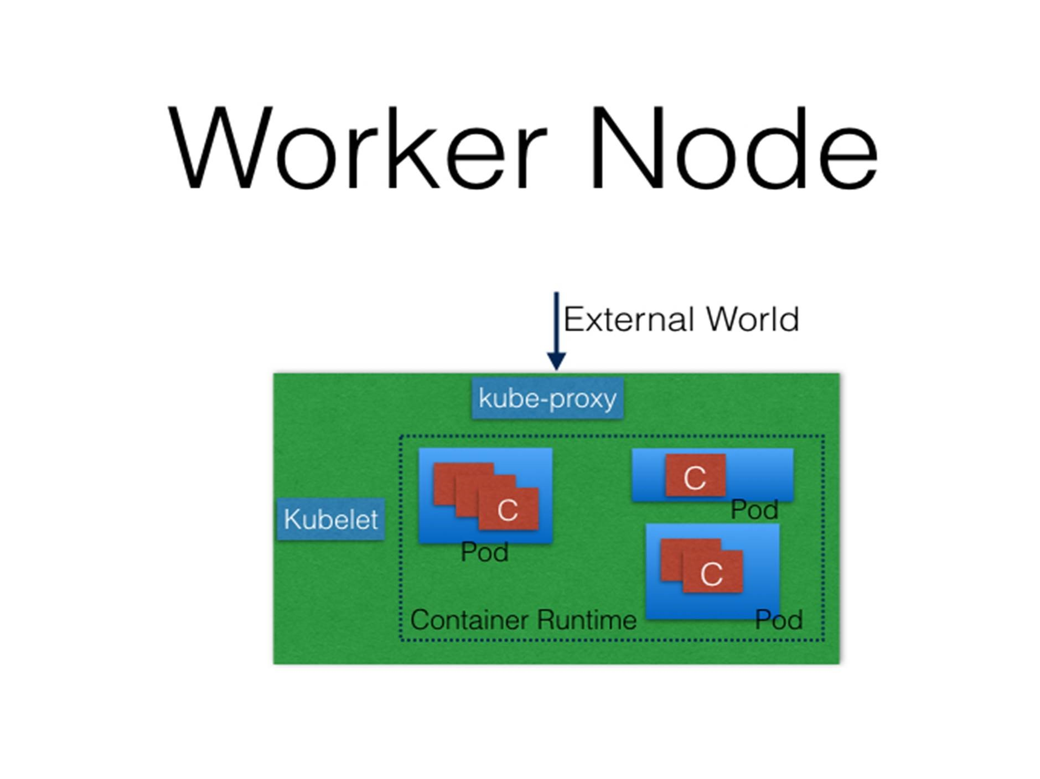
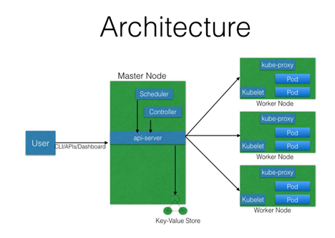
What is Container Networking Interface (CNI)
Revisiting k8sArchitecture
Taking about KubeProxy
Notes:
API Server - All the administrative tasks are performed via the API Server within the Master Node. A user/operator sends REST commands to the API Server, which then validates and processes the requests. After executing the requests, the resulting state of the cluster is stored in the distributed key-value store.
Scheduler - As the name suggests, the Scheduler schedules the work to different Worker Nodes. The Scheduler has the resource usage information for each Worker Node. It also knows about the constraints that users/operators may have set, such as scheduling work on a node that has the label disk==ssd set. Before scheduling the work, the Scheduler also takes into account the quality of the service requirements, data locality, affinity, anti-affinity, etc. The Scheduler schedules the work in terms of Pods and Services.
Controller Manager - The Controller Manager manages different non-terminating control loops, which regulate the state of the Kubernetes cluster. Each one of these control loops knows about the desired state of the objects it manages, and watches their current state through the API Server. In a control loop, if the current state of the objects it manages does not meet the desired state, then the control loop takes corrective steps to make sure that the current state is the same as the desired state.
Etcd - As discussed earlier, etcd is a distributed key-value store which is used to store the cluster state. It can be part of the Kubernetes Master, or, it can be configured externally, in which case, Master Nodes would connect to it.
Worker Nodes -A Worker Node is a machine (VM, physical server, etc.) which runs the applications using Pods and is controlled by the Master Node. Pods are scheduled on the Worker Nodes, which have the necessary tools to run and connect them. A Pod is the scheduling unit in Kubernetes. It is a logical collection of one or more containers which are always scheduled together.

Slide 3
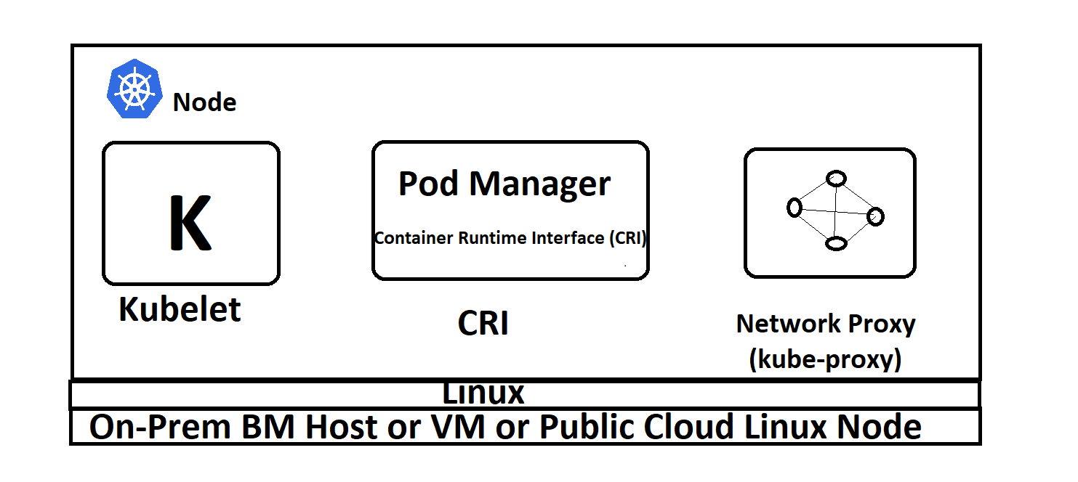
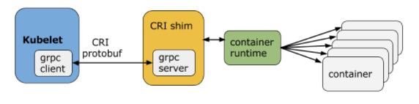
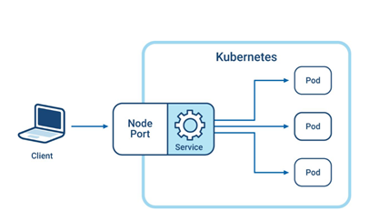
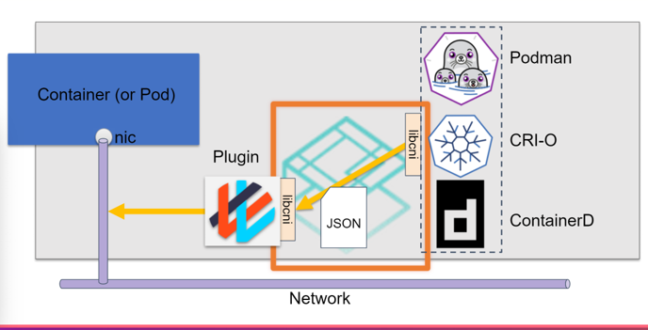
What is Container Runtime Interface (CRI) & how it helps manage Containers (RunC)
Mutiple PoDs Run on a Node
Kubelet(Node) to CRI using gRPC client to CRI Shim to RunC
Notes:
Container Runtime To run containers, we need a Container Runtime on the Worker Node. By default, Kubernetes is configured to run containers with Docker. It can also run containers using the rkt Container Runtime.
kubelet The kubelet is an agent which runs on each Worker Node and communicates with the Master Node. It receives the Pod definition via various means (primarily, through the API Server), and runs the containers associated with the Pod. It also makes sure the containers which are part of the Pods are healthy at all times. The kubelet connects with the Container Runtimes to run containers. Earlier, the kubelet and Container Runtimeswere tightly coupled. There is work in progress for the Container Runtime Interface (CRI) to have a pluggable CRI and project CNI is Incubation.

Slide 4
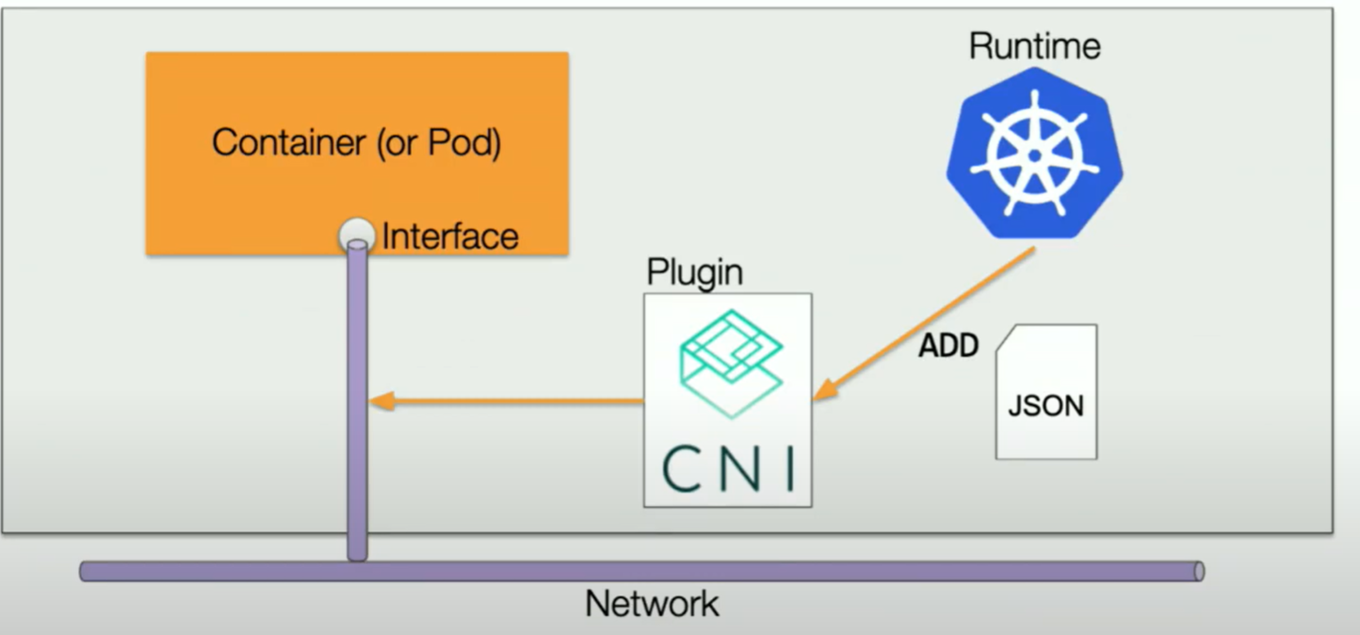

Role of CNI in a K8s Cluster
libcni –cni / plugin https://github.com/containernetworking
CNI Project in CNCF
CNI (Container Network Interface), a Cloud Native Computing Foundation project, consists of a specification and libraries for writing plugins to configure network interfaces in Linux containers, along with a number of supported plugins. CNI concerns itself only with network connectivity of containers and removing allocated resources when the containner is deleted.
Refer - https://www.cncf.io/projects/
Notes:
Networking setup challenges
To have a fully functional Kubernetes cluster, we need to make sure of the following:
Assign a unique IP address to each Pod?
In Kubernetes, each Pod gets a unique IP address. For container networking, there are two primary specifications:
Container Network Model (CNM), was proposed by Docker
Container Network Interface (CNI), was proposed by CoreOS.
Kubernetes uses CNI to assign the IP address to each Pod.

Slide 5
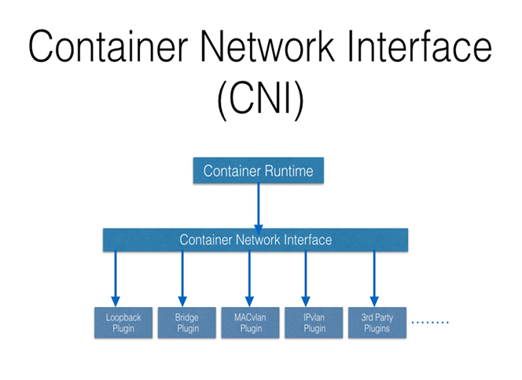
Kubernete DNS
Cluster DNS
Basic & Production Plugins (3rd Party Calico, Weave…)
On-Prem can use
Coredns.io
Container-to-Container Communication Inside a Pod
CRI create an isolated network entity for each container that it starts. On Linux, it is referred to as a Network Namespace. These Network ns can be shared across containers, or with the Host OS
Inside a Pod, containers share the Network ns, so that they can reach to each other via localhost.
Pod-to-Pod Communication Across Nodes
Is Pod able to communicate with other Pods in the cluster?
How? Routable Pods and nodes, using the underlying physical infrastructure or as pure L3 overlay like Calico with cluster DNS+IPAM or through VXLAN tunnels etc.
The Container Runtime offloads the IP assignment to CNI, which connects to the underlying configured plugin.Once the IP address is given by the respective plugin, CNI forwards it back to the requested Container Runtime

Slide 6
CNI - the Container Network Interface
Refer : https://github.com/containernetworking/cni/blob/master/SPEC.md#network-configuration
Important is Vendor Neutral Specs to add CNI & later Plugins
Used by Mesos, Cloud Foundry, podman, CRI-O, container-D
Defines Basic Execution of flow like Add Or Del the Plugins

Slide 7
Container Networking, CNI and Network-Configuration
/opt/cni/<plugins>
/etc/cni creates CNI config
/etc/cni
Kubectl ctool is used to manage cni manually or imperatively
K8s CNI APIs are used for Descriptive YAML/JSON based automation

